Slide 1

Project 3: Tennis Betting Analysis
Manuel Duran DSC 680 (12 Mins 5 Seconds)

Slide 2

Presentation Agenda
Data Understanding\Preparation
EDA
Methods\Results
Conclusions\Recommendations

Slide 3
Data Preparation\Understanding
Data Acquired: Tennis-Data.co.UK
Tennis Data since 2020
Various Tennis Statistics and Information
Created Spreadsheet for analysis

Slide 4
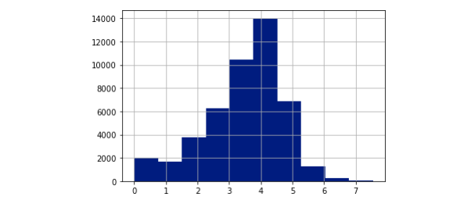
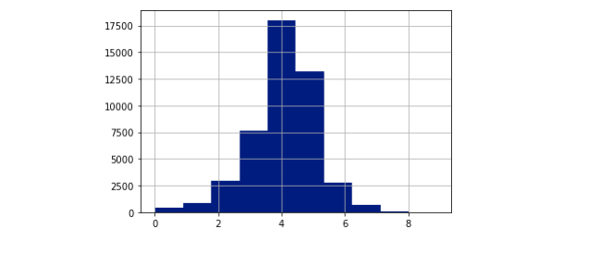
EDA
Histogram: Winners Rank
Histogram: Loser Rank

Slide 5
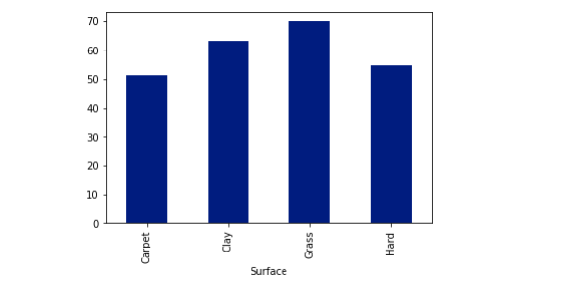
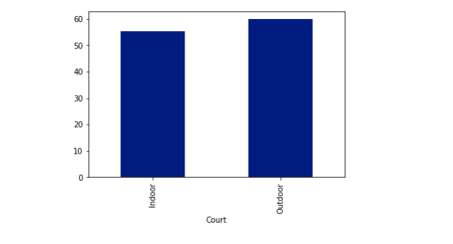
EDA cont.
Outdoor\Indoor Bar Chart
Surface Bar Chart

Slide 6
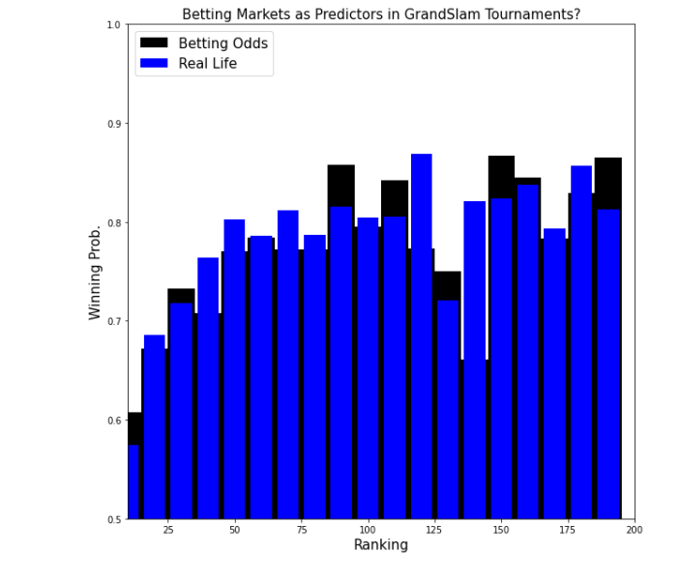
Methods\Results
Comparison of Betting Market to Actual Results of Match

Slide 7
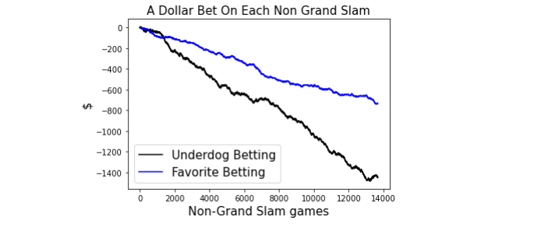
Methods\Results
Non-Grand Slam Betting Analysis

Slide 8
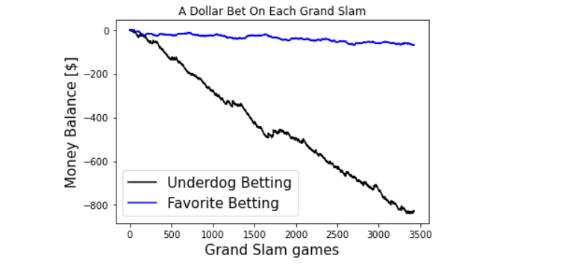
Methods\Results Cont.
Grand Slam Betting Analysis: Favorites vs. Underdogs

Slide 9
Conclusion\Recommendation
Recommendation: Do Not Follow Basic Strategy
Account for Sportsbook “Juice” in the Lines
Example: -350 – Risk 350 to Win 100
Focus on Spread Betting or Bets with Even Odds

Slide 10
Contact Information
Github: https://github.com/mannyoduran/DSC680-Projects
Contact: Mannyoduran@gmail.com

